Slide 1


Project Orangina
Management Board Presentation #1 July 2021
Strictly Private and Confidential

Slide 2
Executive Summary
Portfolio Summary
The portfolio consists of 29 assets, generates a NRI of € 5.0m p.a. at entry with a purchase price of € 80.6m.
Orangina has an entry WALT of 7.9 years*, a FMCG share of 89% and a West share of 22%.
xx anchored by xx, xx and xx by xx.
Investment Rationale
xx.
Background
xx.
Timeline & Next Steps
xx.
To be updated
*as per 01.02.2022

Slide 3
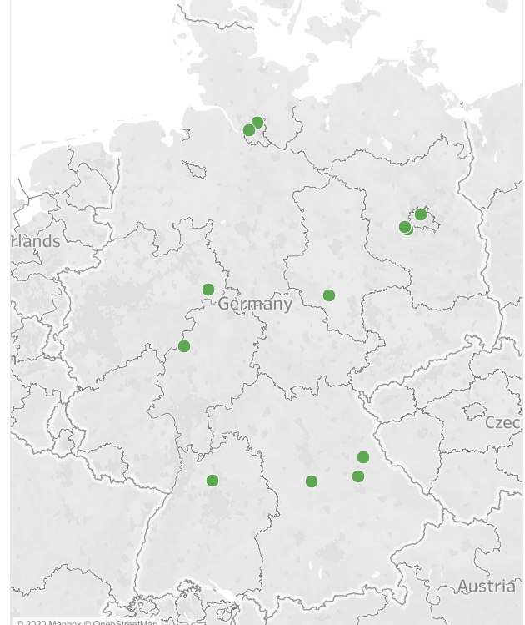
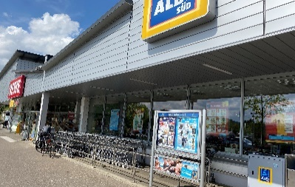
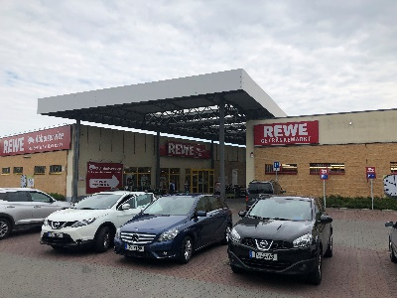
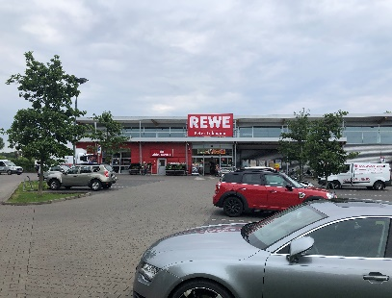
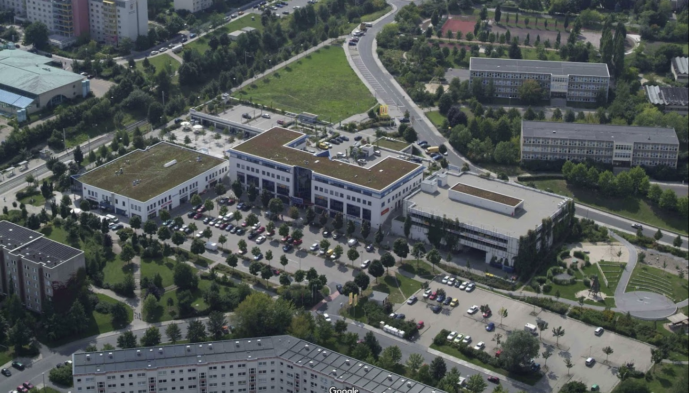
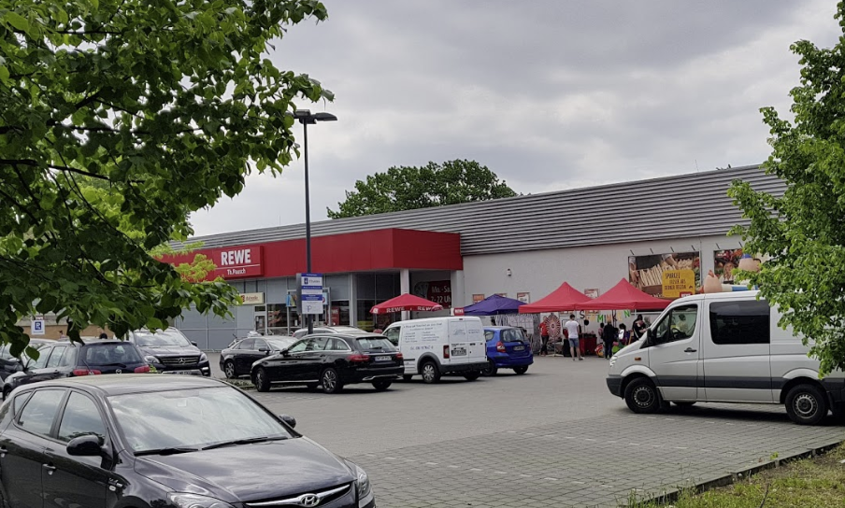
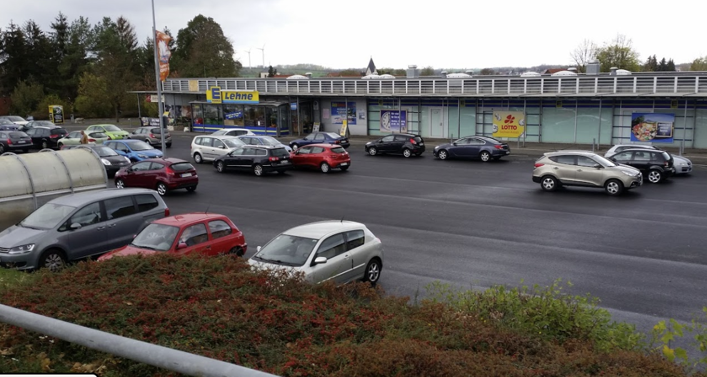
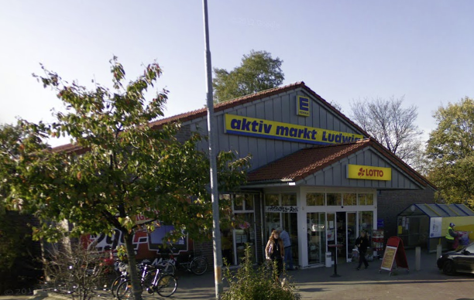
Portfolio Overview
Asset Impressions
ID7 - Leingarten
ID8 - Potsdam
ID13 - Potsdam
To be updated
ID12 – Berlin
ID21 – Helbra
ID24 – Hamburg
Key Facts
The portfolio consists of 29 Assets. WALT of 7.9 years as of BP start NRI of c. €5.02m at Entry OpEx leakage of approx. 12.1% incl. PM and void costs) Total lettable area of 44,576 sqm In Place Occupancy of 98%
Geographical Distribution of NRI
FMCG Share by NRI
Strategy by NRI
*as per 01.02.2022

Slide 4
Economic Summary

Slide 5
Sensitivitiy Analysis
*

Slide 6
FFO Yield
*

Slide 7
Profit per Strategy
*
*
Definition of Asset Strategy Clusters
LTS: „Long Term Stabilized“ – are properties with no early extension or other value creation potential. They are stabilized as they are today. AVC1: „Additional Value Creation 1“ – are properties where we plan on creating value by prematurely extending leases, often by granting fit out contributions or rent free periods AVC2: „Additional Value Creation 2“ – are properties earmarked for area expansions. Where necessary we need to amend the zoning plans and obtain preliminary building permits. PTS: „Price to Sell“ – are properties that don‘t strategically fit our investment criteria, have no upside potential and have a more challenging outlook. * Pre-tax

Slide 8
Standalone Conformity Analysis

Slide 9
Orangina Portfolio Conformity Analysis incl. Reverse
*
*
**
Investment Criteria on a x+bricks portfolio level that deviate from the target by more than 10%:
East Share
Transaction Costs
*Includes Mezzanine Loans of Nakeda and Reverse

Slide 10
Due Diligence & Closing Costs

Slide 11
2.5 | Cash Flow
We hereby request your approval to proceed with the proposed transaction and xxxxx.

Slide 12
Appendix

Slide 13
Asset List

Slide 14
Tenant Mix
*WALT as per 01.02.2022

Slide 15
Envisaged Transaction Structure
I. Financing
Financing is x+bricks’ responsibility.
Exclusivity Agreement does not require a down payment, a specific equity commitment or a proof of funds / financing confirmation.
Acquisition Agreement shall require a €4.5m down payment.
II. W&I Insurance
To be updated
W&I Insurance in line with Reverse (in relation to a customary warranty catalogue without further recourse to TLG) to be concluded by 2 October 2020.
TLG to bear W&I costs up to €100,000, remainder to be borne by purchasers.
III. Documentation
Acquisition Agreement shall be based on the Reverse precedent, but
without revocation right; and
adjusted for specifics of the relevant properties.
IV. Closings
Acquisition shall be executed by way of an asset deal.
Exclusivity Agreement generally envisages one closing on the last day of a calendar month.
If, by 16 October 2020, not all closing conditions are met, x+bricks may (in its sole discretion) request two closings, the first one to occur upon x+bricks’ requests (without minimum requirement) and the second one occurring once all remaining properties can be transferred.
127850703 v1

